Slide 1


Sentiment Classification of Microblogs

Slide 2
Contents
A peek into the Solution
Problem Statement
Understanding the Data
Data Cleaning
Feature Extraction
Model Building
Analysis of the results

Slide 3
A peek into the Solution

Slide 4
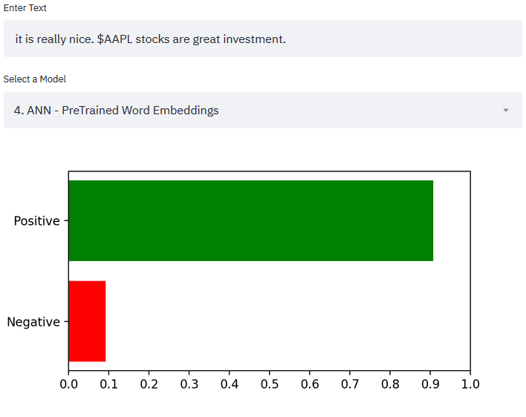
A peek into the Solution
Live Sentiment Classifier
Features
Live sentiment classification of text entered in the input field
Functionality to select other top performing models for evaluation
NAME OR LOGO

Slide 5
Understanding the problem statement

Slide 6



Problem statement
Sentiment Classifier
Positive
Microblog
Negative
This Photo by Unknown author is licensed under CC BY-SA.
This Photo by Unknown author is licensed under CC BY-NC.

Slide 7
Understanding the Data

Slide 8
Understanding Data
Raw Data: (1700 rows and 5 columns)
cashtag | id | sentiment score | source | spans
$AAPL | 719886818800463000 | 0.435 | twitter | ["#OwnItDon'tTradeIt"]
$TVIX | 30158448 | -0.589 | stocktwits | ['100.0% increased bearish conversations'].
$KOL | 25043071 | -0.362 | stocktwits | ['Coal stocks are poking their head up', 'very nice weekly candle']
... | ... | ... | ... | ...
Data description:
Column Name | Data Type | Description
cashtag | string | Company ID/Name in Stock Market
id | int | Id of the row ( unique to each source )
sentiment score | float | Continuous polarity score denoting the sentiment ( -1 to 1 )
source | string | Web source of data ( Twitter or Stocktwits )
spans | list | List of phrases of each microblog
NAME OR LOGO

Slide 9
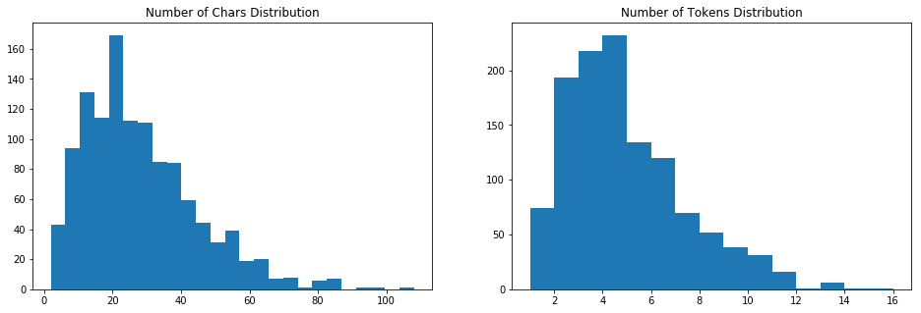
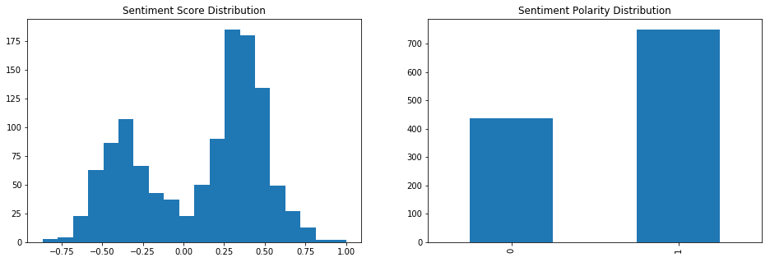
All numbers on y-axes denote the number of sample in a given bucket
Sentiment Polarity is a discrete feature mined from Sentiment Score column (0 – Negative, 1 – Positive )
Exploratory data Analysis

Slide 10
Data Cleaning

Slide 11
Data Cleaning
Join Individual Sentences
Remove duplicate Strings
Remove Company Tags
Clean text in hashtags
Clean & preserve Negation
Stop Word Removal
Encode Numeric tweets
Remove Punctuation, special characters & numbers
Tokenize & Lemmatize

Slide 12
Data Cleaning
1. Join Individual Strings
[''$AAPL stocks will go up soon'', '#ownitdon'ttradeit']​
''$AAPL stocks will go up soon #ownitdon'ttradeit'
Raw text data contains multiple phrases per row
These phrases are joined to form a single string of text per each row
2. Remove Duplicate Strings
Data contains rows with duplicate strings and sentiments as shown in the table below.
cashtag | id | Sentiment score | source | spans
$OPTT | 22409313 | 0.38 | stocktwits | ["Buy the dip'"]
$OMER | 22409313 | 0.38 | stocktwits | ["Buy the dip'"]
$TGA | 22409313 | 0.38 | stocktwits | ["Buy the dip'"]
$KNDI | 22409313 | 0.38 | stocktwits | ["Buy the dip'"]
... | ... | ... | ... | ...
Data is hence deduplicated for making the model unbiased to any particular sample which increases the generalizability. (detailed explanation of why duplicates are removed can be found in the appendix)

Slide 13
3. Remove Company Tags
The strings contain company tags (identified by words starting with $). These carry no information relevant to sentiment classification & hence are removed
'$AAPL stocks will go up soon #ownitdon'ttradeit'
'stocks will go up soon #ownitdon'ttradeit'
4. Clean text in hashtags
Text embedded in hashtags often carry crucial information essential for sentiment analysis
The data is extracted from social platfroms Twitter & stocktwits where use of hasttags is quite common.
People use hash tags to summarize their sentiment/ emotions or group the post with similar content on the platform.
Hash(#) symbool is stripped from each hashtag string and the resulting text is then split into meaningful words
'stocks will go up soon #ownitdon'ttradeit'
'stocks will go up soon own it don't trade it'

Slide 14
5. Clean & preserve Negation
The word 'not' is generally considered as a stop word in most of the NLP tasks
But presense of a not makes a huge diffrenece in sentiment analysis
Hence preserving it is essential
Not is often written in short form "n't" combined with helping verbs like 'can', 'should' etc
It is straight forward to just replace the "n't" word with " not"
Only the following four cases need special correction ( shan't, won't, ain't, can't)
'stocks will go up soon own it don't trade it'
'stocks will grow soon own it do not trade it'
6. Stop Word Removal
Every language contains a few most common words
These words generally do not add extra value to the task at hand( sentiment analysis). Moreover including them can incerase the dimensionality dramatically and often could lead to overfitting
Hence such words are eliminated.
A few special words that matter in the current context ( stock market data ) are excluded.eg:- up, down, drop, over, under etc
'stocks will go up soon own it do not trade it'
'stocks go up soon own not trade'
* 'up' & 'not' are still present although they are stopwords

Slide 15
7. Encode Numeric strings
Number following the symbols '+', '–' or blank space & not followed by '%' (e.g. 73.5, +450, -105) carry information about stock price movements which inherently carry information essential for sentiment analysis.
Hence any positive number is encoded as 'increase', negative as 'decrease'.
Numbers following the symbols '+', '–' or blank space & followed by '%' (e.g. 13.5%, +4.5%, -1.05%) carry information about stock price movements which inherently carry information essential for sentiment analysis.
Hence any positive number is encoded as 'percent increase', negative as 'percent decrease'.
Note:- We need not worry about the magnitude of number as we are just interested in building a classifier for positive or negative outputs. Had this been a regression problem to predict a sentiment score rather than category then it makes sense to make buckets of changes and then encode them
8. Remove puncuation & special characters
Punctuations and special characters do not carry any information that can be useful for sentiment classification & hence can be ignored

Slide 16
9. Tokenize, Lemmatize
Lemmatization reduces inflectional/ derivated forms to base form of a word. Derived word of a word already seen by the model while training will not be something new altogether.

Slide 17
Feature Extraction

Slide 18
Feature Extraction
Word2Vec
Self Trained
Pre Trained
Document Level Features
Word Level Features
Pre Trained
Self Trained
Bag of Words
TfIdf
Word2Vec

Slide 19

Model Building

Slide 20
Models that were tried
Logistic Regression
SVM
Random Forest
Deep Neural Network
Convlutional Neural Network
Recurrent Neural Network (LSTM)

Slide 21
Training Procedure
Test Train Split
Feature data is split into test and train via stratified sampling on y to ensure the same distribution of y in boh test & train sets
Data Imbalance
As it is evidant from the 'sentiment polarity' bar graph, positive samples are nearly 2 times the number of negative samples.
Ways to deal with imbalanced data:
Over or undersampling (SMOTENC)
Modification of Class weight to compensate for the imbalance
Class weight modification method is followed while training for all the classifiers trained
Cross Validation
As the total number of samples are quite less, model could easily run into overfitting problem.
Hence every classifier is trained with cross validation steps to maximize the 'accuracy_score' or 'f1_score' for validation data
HyperParameter tuning is done for classifiers to find the best possible set of parameters in the given setting of training

Slide 22
Results Analysis

Slide 23
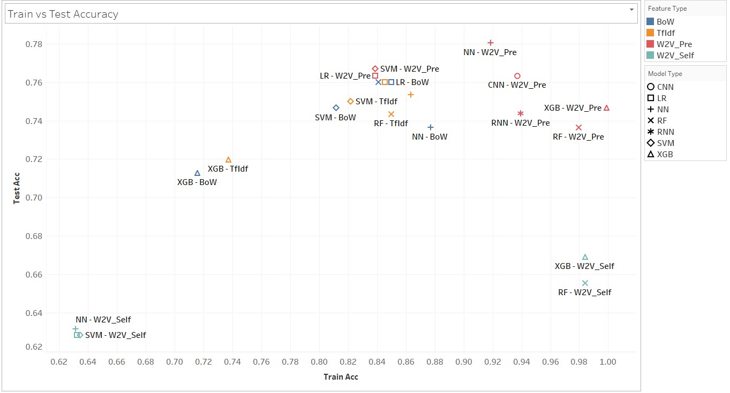
Train vs Test Accuracy
* Detailed scores list can be referred in Appendix
Plot compsrison of train accuracy snd test accuracy pof different models tried
X denotes Train accuracy & Y denotes Test Accuracy
Ideally the model that is farthest from origin & less difference between train and test accuracies is preferred

Slide 24
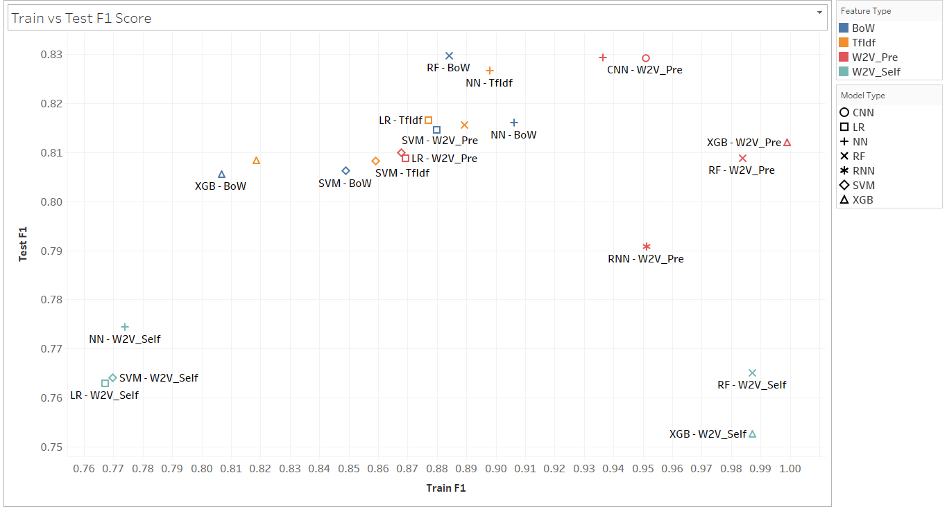
Train vs Test F1 Score
* Detailed scores list can be referred in Appendix
Plot compsrison of train f1 score snd test f1 score of different models tried
X denotes Train f1 score & Y denotes Test f1 score
Ideally the model that is farthest from origin & less difference between train and test f1 scores is preferred

Slide 25
Observations
Pretrained Word Embeddings are the best performing feature types in any given model followed by TfIdf & Bag of Words
Self Trained Word Embeddings are the worst performing feature types. Since the size of data is considerably less, self trained vectors are not good enough compared to embeddings pretrained on 6 Billion Tokens
Neural Network models seem to be underfitting for sparse feature types ( Bag of words & TfIdf ) with activation functions 'sigmoid' & 'tanh'. These activations transform an input data into [0,1] or [-1, 1] range. If data is highly sparse, most of them get mapped to either maximum or minimum and heence lowering the learnability. ReLU on the other hand resulted in accuracy comparable to other models

Slide 26

Appendix

Slide 27
Why Duplicates were removed?
To answer this we need to know to answer "When to remove duplicates and when not to?" It depends on
Nature of data
Problem in hand
Nature of Data: It makes sense to keep duplicates if the data is completely structured and closed to a limited set.
Let's assume we have a data with a binary independent variable x (eg:- raining Yes/No) & a binary target variable y (traffic jam Yes/No). The data has 100 rows and follows the distribution below(left).
The reason we need not remove duplicates here is, the data is structured and closed to a limited set. Any future data that the model will see follows the same structure and follows the same statistical distribution as the training data. Hence it makes sense to capture this information by keeping the duplicates.
But clearly the text data that our model sees is not structured and need not follow the same distribution as the training set.
Task in hand: Unlike other modelling tasks nlp tasks are more focused on learning a functionality( sentiment classification) on a given set that can be used on any open data.
This means, even if our model sees a completely different text instance than those encountered while training, it should still identify the sentiment.
"No sample is superior than the other". Understanding is prioritized more than memorization. So duplicates need to be removed
x/y | 0 | 1
0 | 30 | 15
1 | 10 | 45
x/y | 0 | 1
0 | 1 | 1
1 | 1 | 1
It's apparent that there are high chances for a traffic jam if it's raining. In this case we want our model to learn this statistical rule. It doesn't make sense to remove duplicates here(this just leaves us with 4 rows which are useless to find any inference)

Slide 28
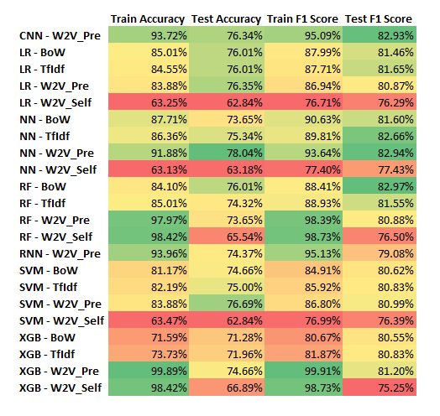
Model Performance Metrics

Slide 29

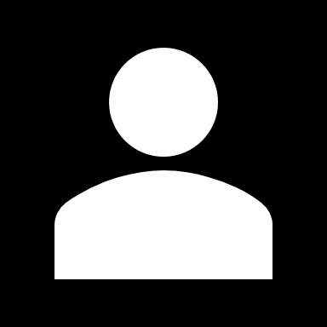
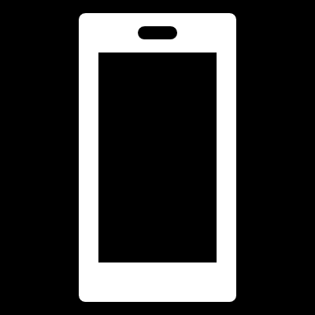

Thank You
Krishna Sai Vootla
+91 9441890179
Vootlsskrishnasai@gmail.com

